Slide 1




Astronomy 1020 chapter 30
Clayton State University
Slides for Astronomy textbook from OpenStax
https://openstax.org/books/astronomy/

Slide 2
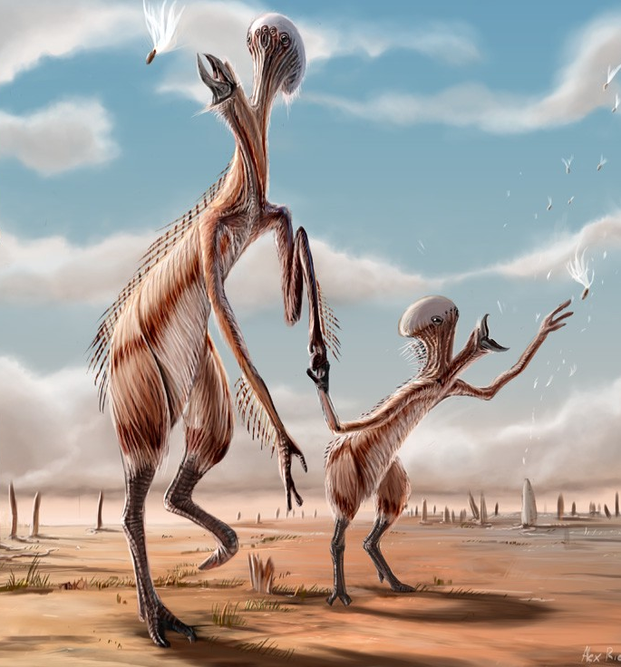
In-class question:
What are your thought on life on other planets
How may aliens / extra-terrestrials look like?

Slide 3
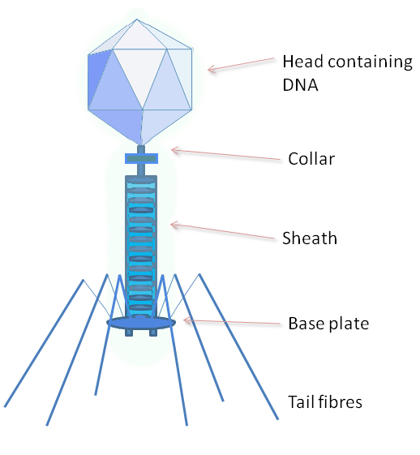
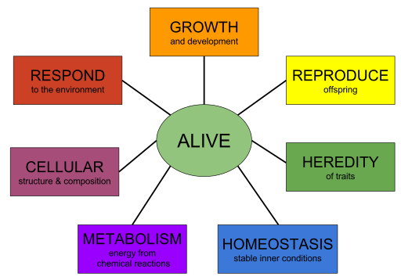
What is life?
Where is the line between alive and not?
Current definition:
  Self-sustaining (self-repairing)
  Self-procreating
Other definitions? Think of viruses for example?
Extended definition →
Bacteriophage schematic

Slide 4
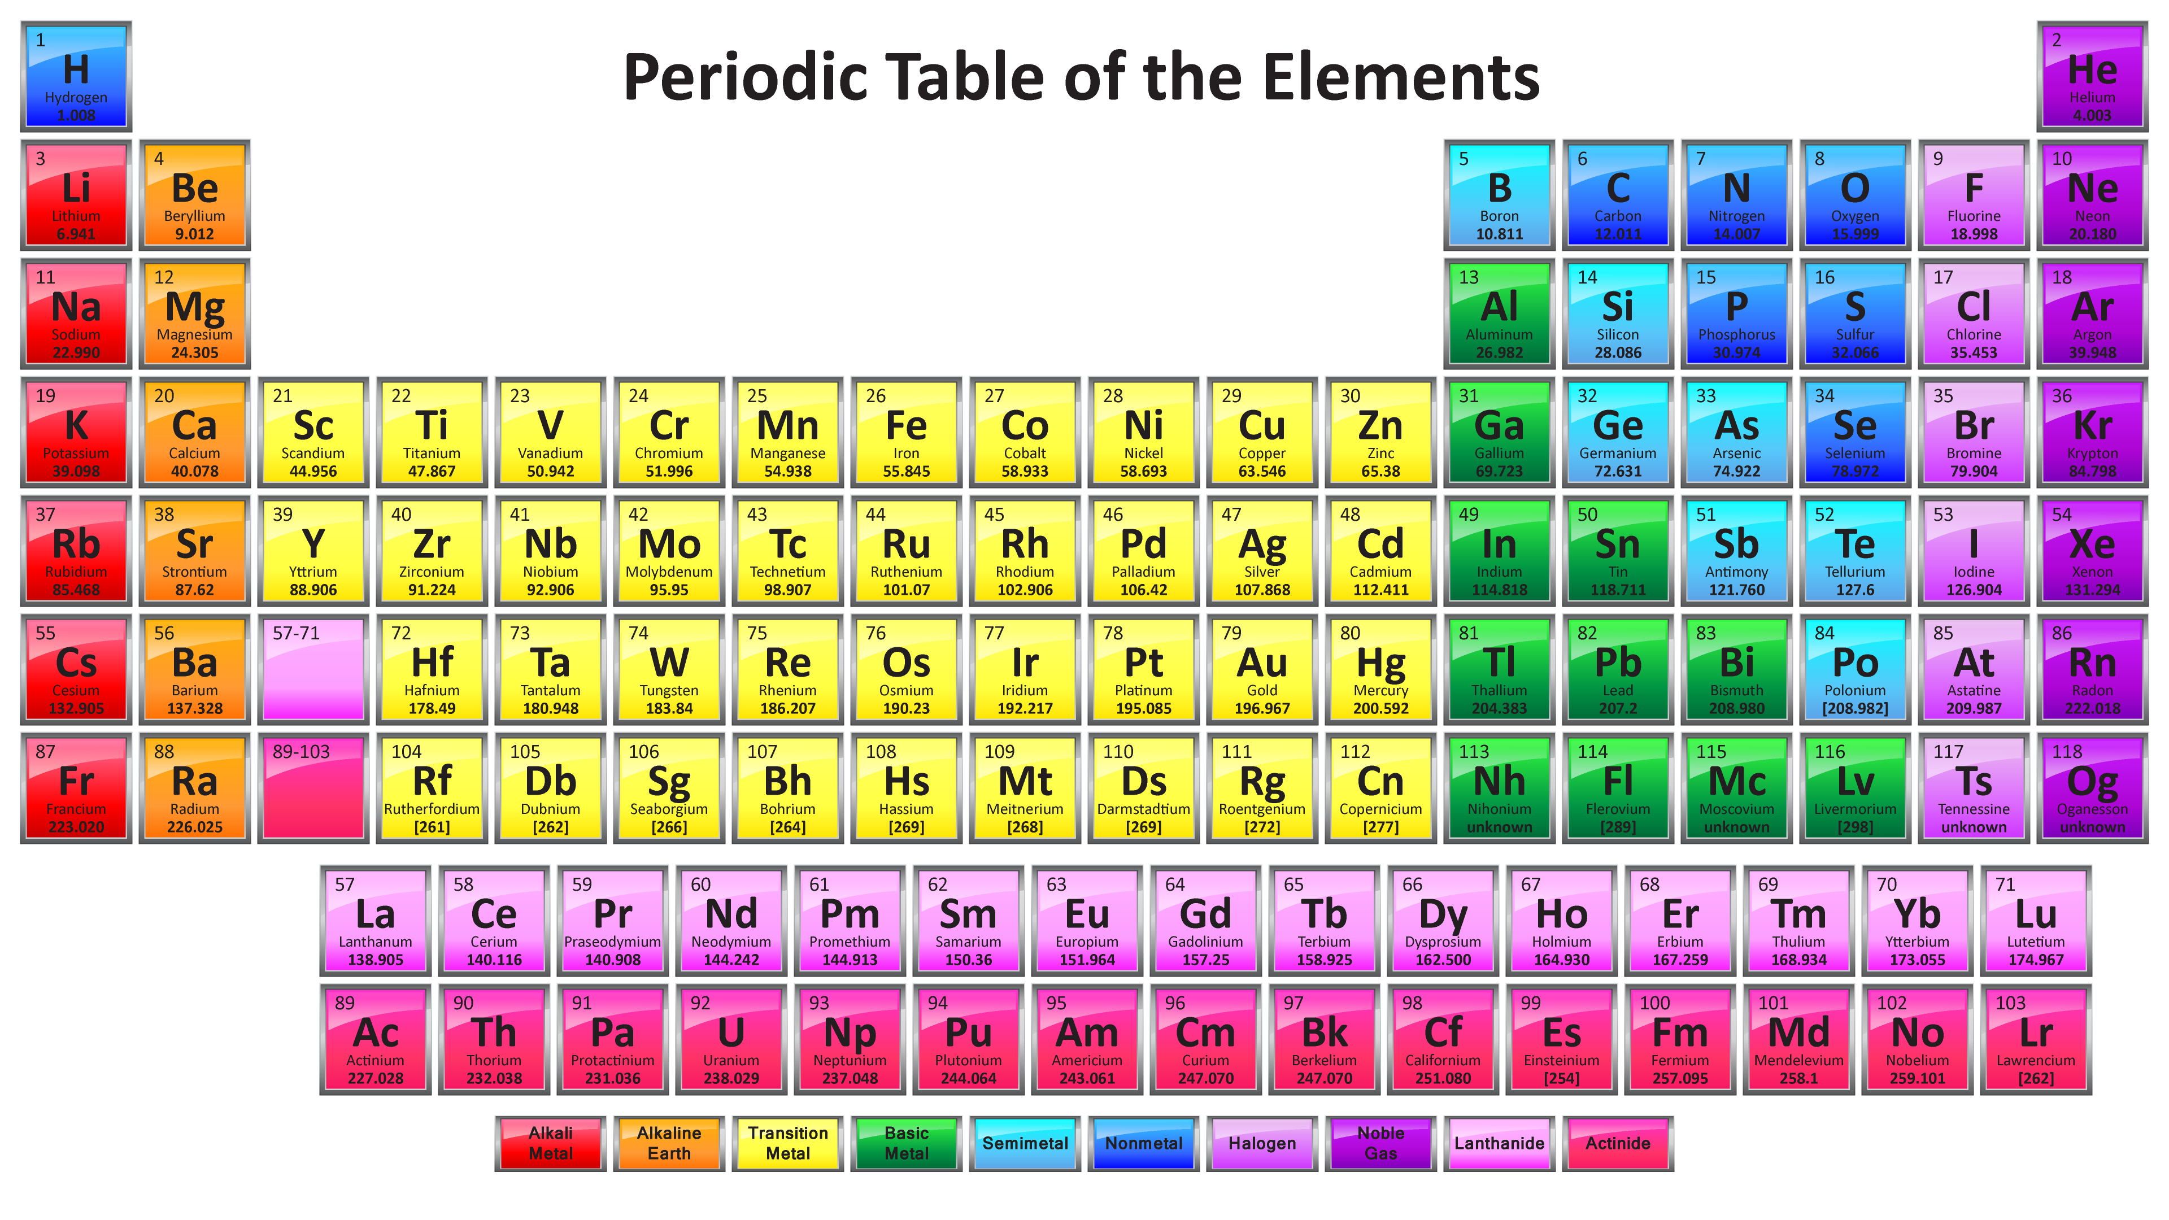
First, what is life based on?
Carbon – 4th most common element after H, He and O. Just following them is N. Other common ones: Fe, Si
So CNO+H life seem most likely. What about rare cases?
What about other possibilities? SiPS? GeAsSe? CNF?

Slide 5
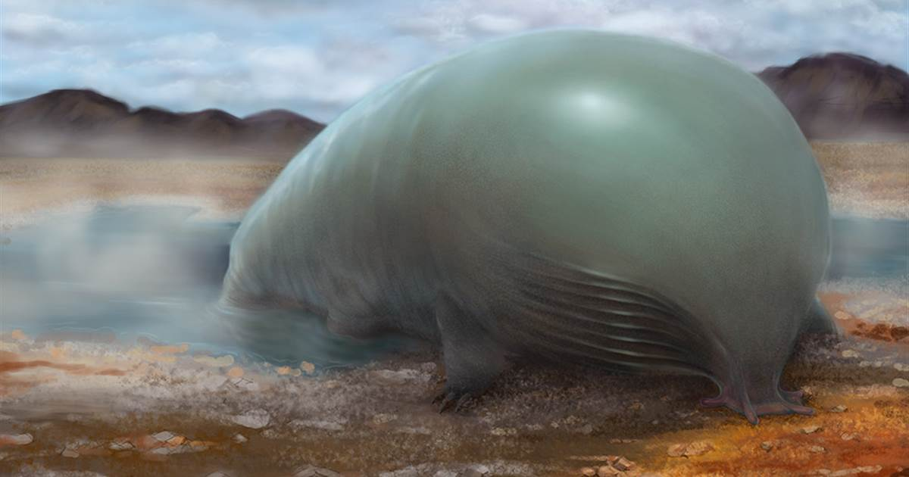
Chemistry of life, Energy?
Oxygen is very electronegative – strong binding – a lot of energy per bond.
Need high energy light to break them. But stable.
Florine has higher energy per bond – very aggressive. Needs high energy photons to break them but cold environment. Chlorine is only a bit less aggressive.
Si is similar to C, but no hybridization – less diversity of compounds. Also, weak bonds – easily broken but needs high heat to stay liquid.

Slide 6
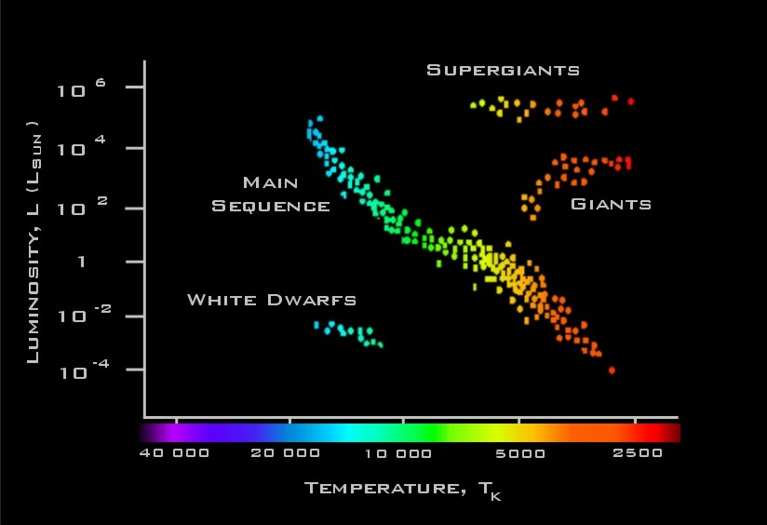
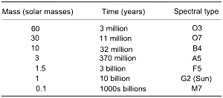
Requirements on the star
Temperature/distance – dependent on chosen chemistry
  Liquid water – blue+red/green (white spectrum) light. Warm environment so water is liquid.
  Liquid hydrofluoric acid – blue+UV, but low temperature!
  Sulfur-based – high T environment, red+IR light…
  Si-based – hot, very bright, but red+orange light
Star stability
Star longevity
Other requirements?

Slide 7
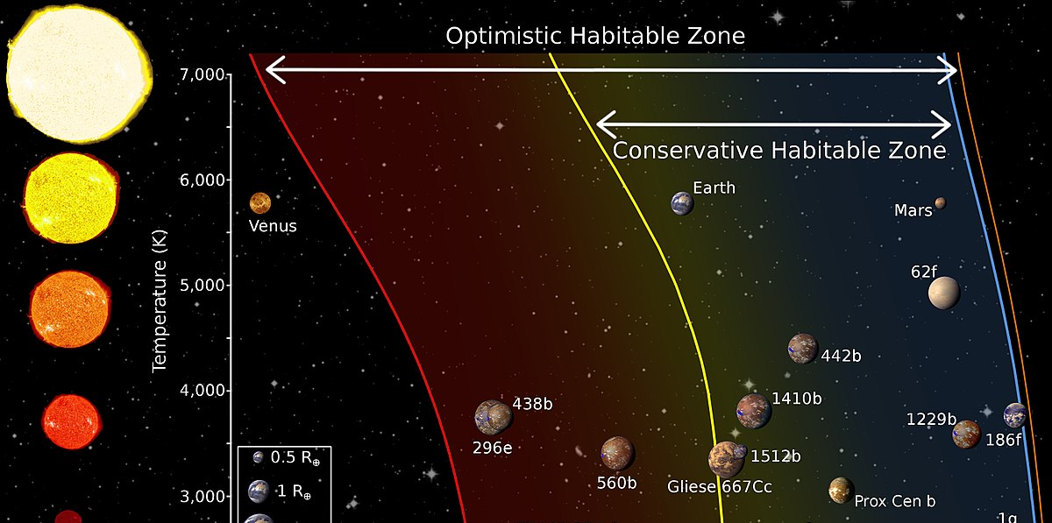
Habitable zone
Requirements:
  water or equivalent: liquid.
  Light energy: below damage (UV for us).
  Stable over time.
  Long lived star.
  No frequent collisions (1 in 65 million years for Earth)

Slide 8
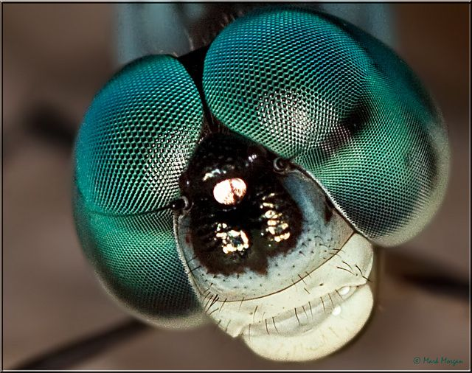
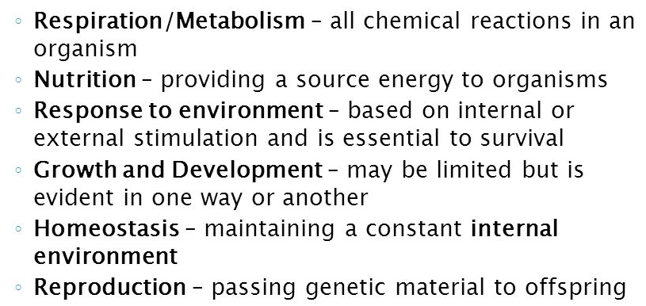
Elements of a living organism to perform functions:
Ingest food and discard waste – needs one mouth-like opening at the very least
Move (find food, avoid dangers) – some appendages are helpful ☺: fins, tentacles, legs, winds, flippers???
See (helps in the above tasks) – photosensitive cells? Perhaps grouped to form better image? Eyes? Simple or faceted/compound? 2 - triangulation!
What about ears? External (like us) or internal (like fish, birds)? Need 2.

Slide 9
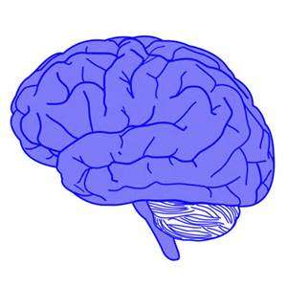
Intelligence – pre-requisites
Why we need brains – evolutionary advantages
  Adaptation
  Memory
  Experience
  All in one place – fast thinking
  Ultimately for survival and reproduction – evolutionary success
What about higher brain activities?
  Social structure
  Helps survival
  Requires much of body resources: 20% for us
What else is gained?
  Tools
  Technological advantage
  Entertainment/arts
  Abstract thinking – bases of intelligence for any species.
What else is needed: Hands or equivalent for tools!

Slide 10
What features intelligent being just can’t have (or rudimentary)
No small bodies (must be proportional to brain size)
No useless heavy features like horns, heavy jaws/teeth, long tails. What about feathery plumage?
Must be able to move and use ‘hands’ at the same time.
Must have efficient metabolism (air breathing for us)
Can not be fragile nor excessively tough (can’t sustain a large brain or has no reason to develop one)
1 leg or many legs – unstable or takes too much brain control to coordinate. Optimum is 2, at most 4? Or 3?
Many hands – why are they needed? Absolute minimum is 1, but its risky as it can be damaged.. So 2 is better. Or 3? 4 is too much?

Slide 11
So, let’s list the results and paint the picture
Has 2-3-4 legs to stand/move, at least 1 agile hand, best 2-3
Mouth or beak, 2 eyes, 2 ears – for triangulation. Nose
Something for communications – can use nose? Sounds are easiest – least energy spent. Electromagnetics are difficult with organic life – we are too slow. But if other base?
Body proportional to brain size. But can’t be very large – depends on gravity, but human-size within factor of 2 or so…
Brain is close to eyes, ears and other main sensors (smell, taste!) so must have something like a head. Which should be able to turn for triangulation.
Draw the picture to best of your ability (see quiz)

Slide 12
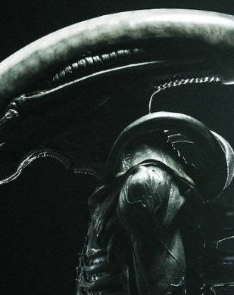
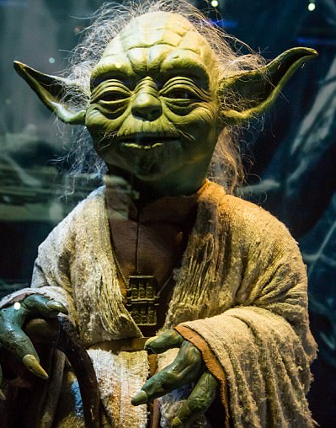
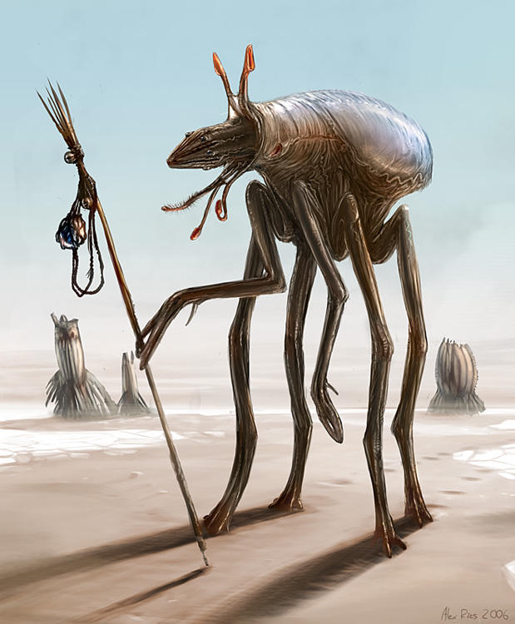
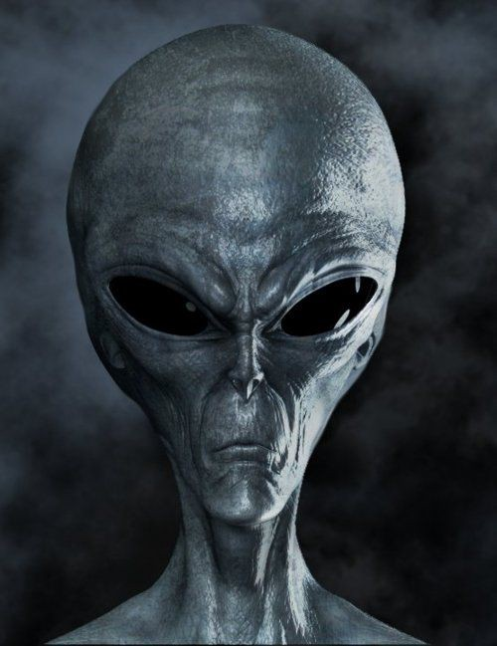
Aliens? Wild ideas from internet

Slide 13
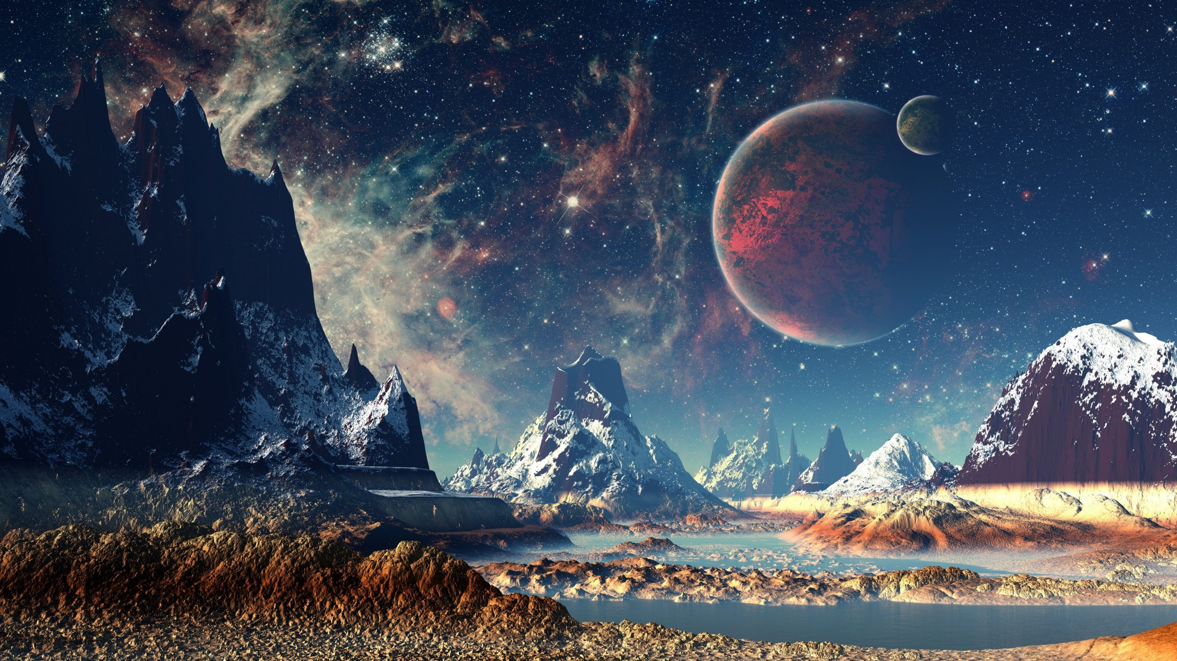
Any Questions?

